Slide 1

COVID-19 World Vaccination Progress
Cloud Computing and Big Data
Mahtab Alghasi
UNICT-2024

Slide 2
Table of contents
01
02
03
CLOUD SETUP
DATA INGESTION
DATA MANIPULATION USING DATABASES
04
05
DATA ENRICHMENT
DATA ANALYSIS USING SPARK NOTEBOOKS
06
DATA VISUALIZATION

Slide 3
Contents of this Report
This presentation focuses on leveraging cloud computing and big data
technologies to analyze and visualize a COVID-19 World Vaccination Progress dataset. It details a comprehensive workflow, starting with setting up a Google Cloud environment and ingesting medical data relevant to COVID-19 World Vaccination.
The dataset is then processed using Google BigQuery for SQL-based manipulation and Databricks for advanced analysis with Spark notebooks. The insights derived from the data are enriched through machine learning applications
and presented via interactive dashboards on Looker.
This integrated approach demonstrates the application of modern cloud
tools to extract actionable insights from healthcare data.

Slide 4
01
CLOUD SETUP

Slide 5
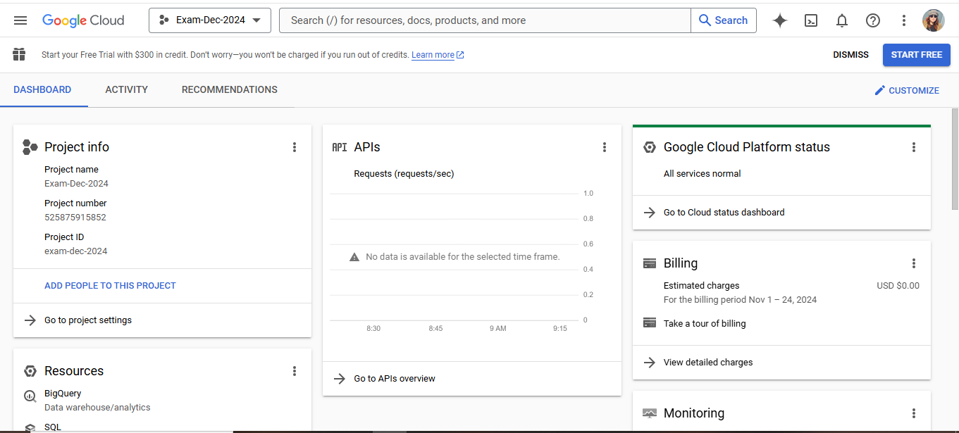
Create a Google Cloud project

Slide 6
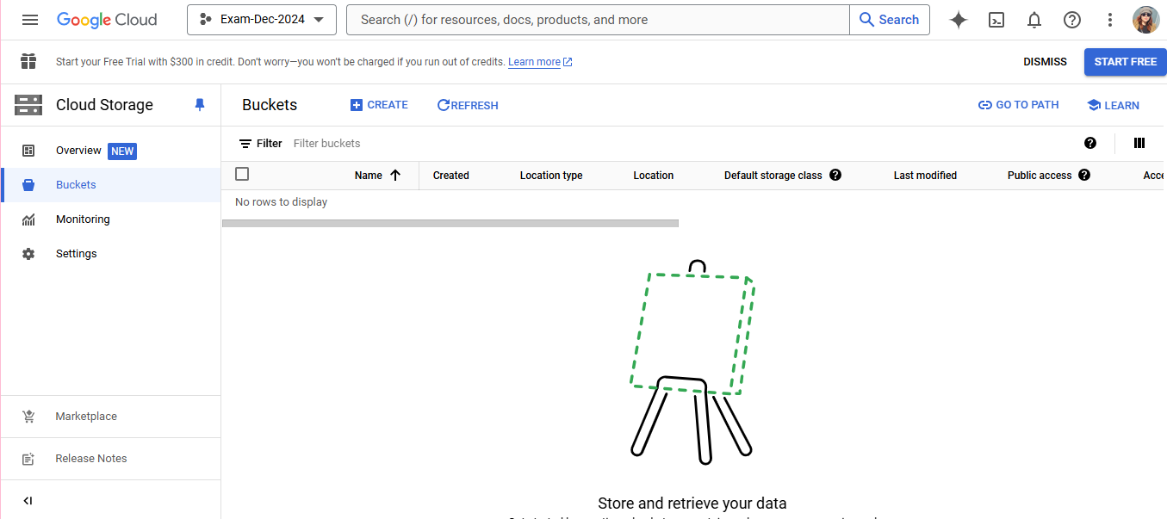
Create a Google Cloud Bucket-01

Slide 7
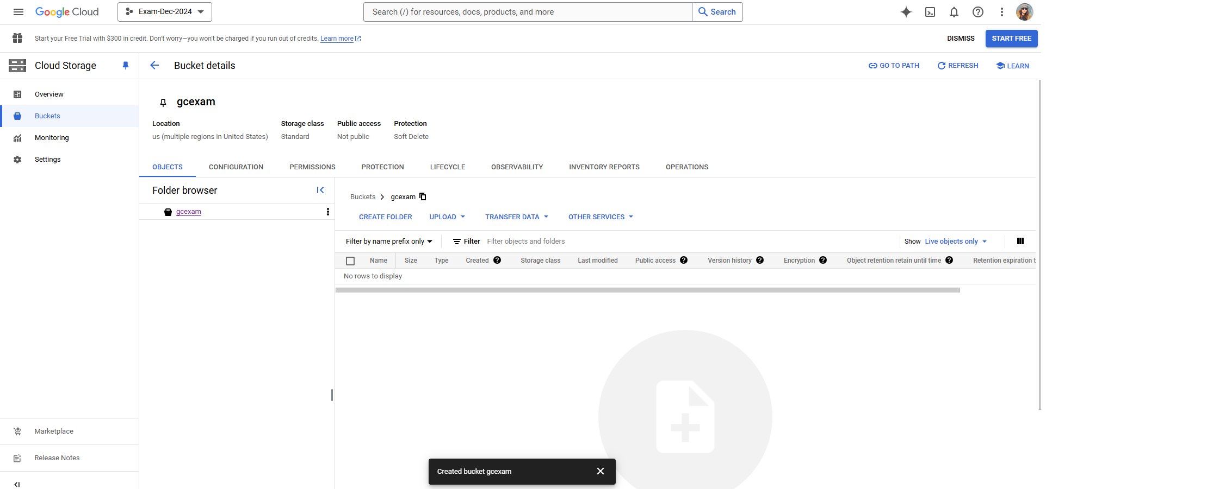
Create a Google Cloud Bucket-02

Slide 8
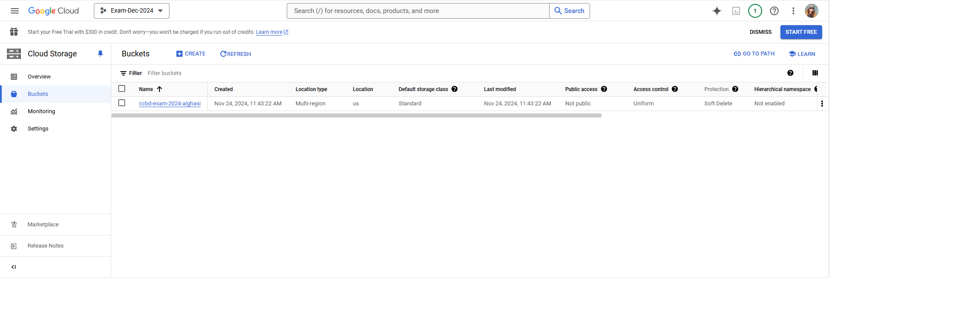
Create a Google Cloud Bucket-03

Slide 9
02
DATA INGESTION

Slide 10
COVID-19 World Vaccination Progress dataset
country: Name of the country where vaccination data is recorded.
iso_code: Three-letter ISO 3166-1 alpha-3 code representing the country.
date: Date of the recorded data in the format YYYY-MM-DD.
total_vaccinations: Total number of vaccine doses administered (both first and second doses included).
people_vaccinated: Number of people who have received at least one dose of a vaccine.
people_fully_vaccinated: Number of people who have received all required doses of a vaccine.

Slide 11
COVID-19 World Vaccination Progress dataset
daily_vaccinations_raw: Raw daily number of vaccine doses administered (unprocessed).
daily_vaccinations: Smoothed daily number of vaccine doses administered (average over a period).
total_vaccinations_per_hundred: Total vaccine doses administered per 100 individuals in the population.
people_vaccinated_per_hundred: Number of people vaccinated with at least one dose per 100 individuals in the population.
people_fully_vaccinated_per_hundred: Number of fully vaccinated people per 100 individuals in the population.

Slide 12
COVID-19 World Vaccination Progress dataset
daily_vaccinations_per_million: Smoothed daily vaccinations administered per million individuals.
vaccines: Names of the vaccines used in the country.
source_name: Name of the organization providing the data.
source_website: Website URL of the data source.

Slide 13
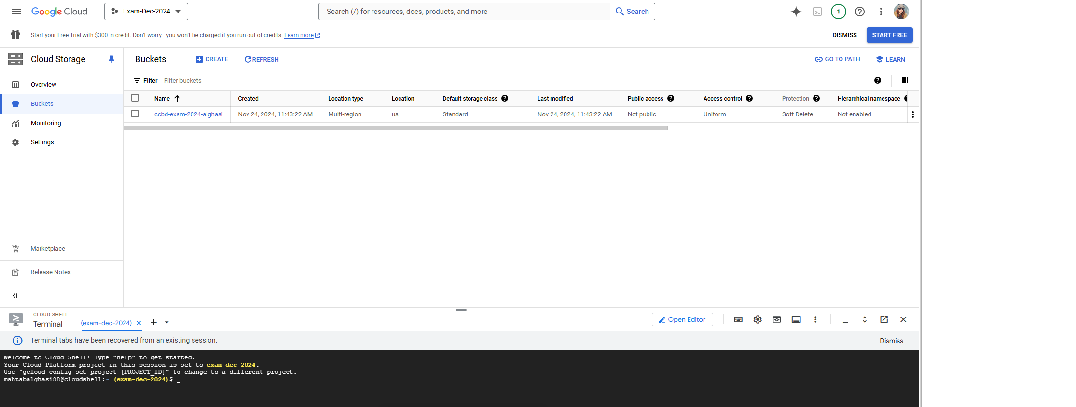
Upload dataset to Google Cloud Storage

Slide 14
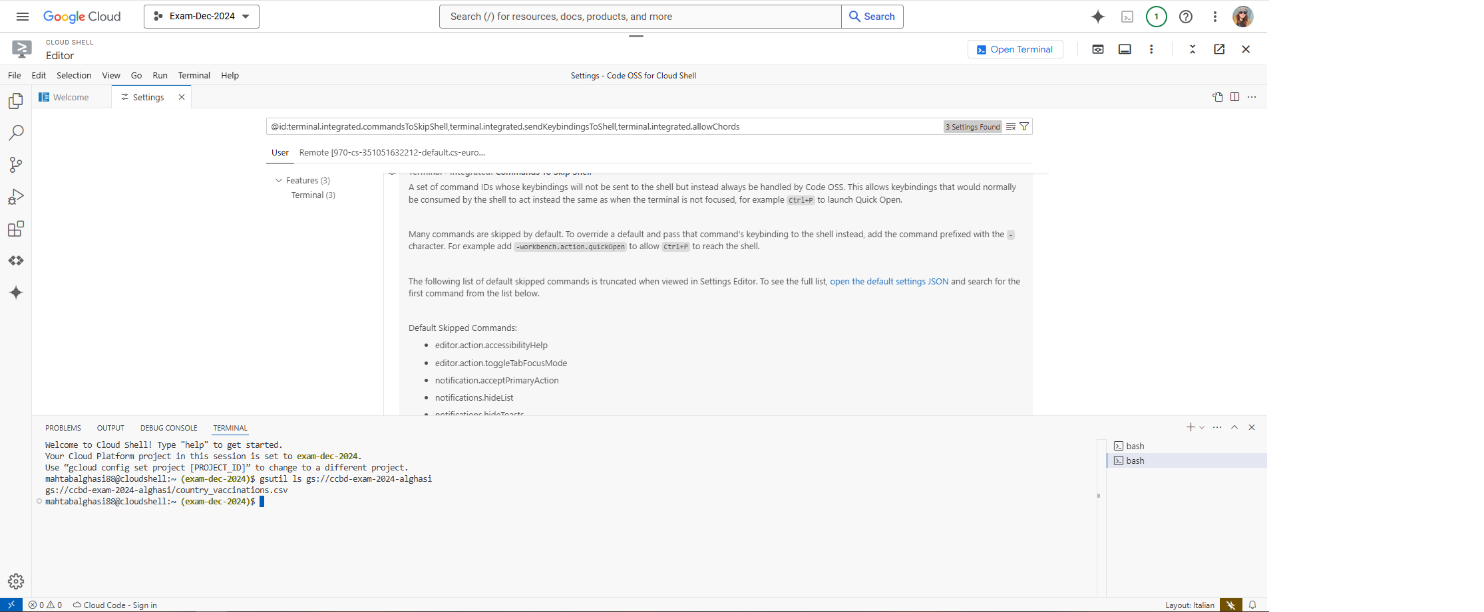
Checking If the File uploaded

Slide 15
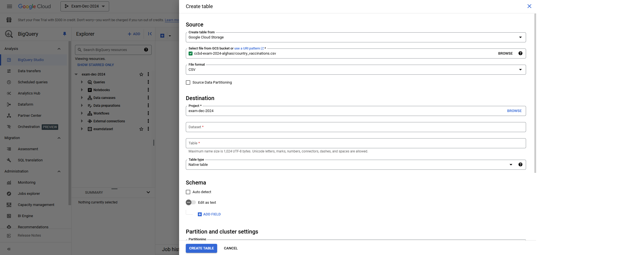
Load the dataset

Slide 16
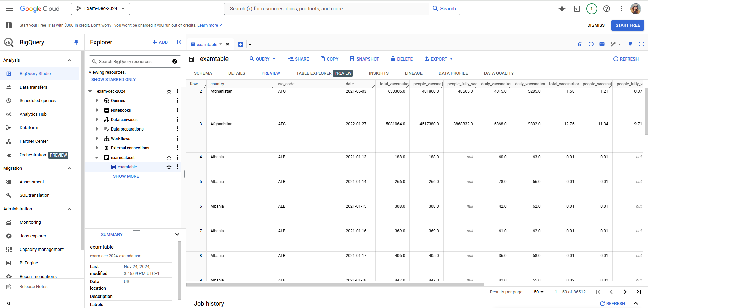
Data preview

Slide 17
03 DATA MANIPULATION USING DATABASES

Slide 18
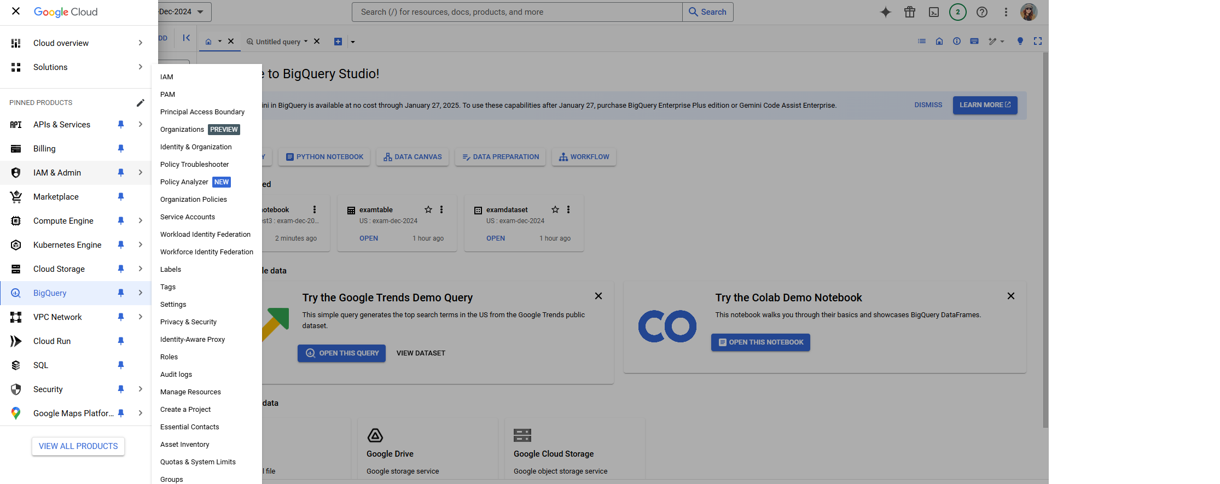
Big Query Console

Slide 19
QUESTIONS
2. What is the daily vaccination trend globally?
1. Which country has the highest total vaccinations?
3. Which vaccine types are most commonly used worldwide?
4. What percentage of the population has been fully vaccinated in each country?
5. What is the relationship between daily vaccinations and the number of people fully vaccinated per country?

Slide 20
Executing queries on Big Query UI

Slide 21
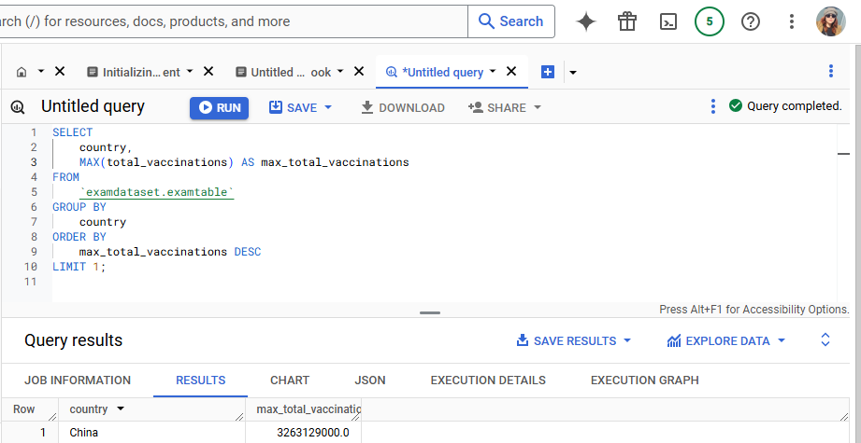
Which country has the highest total vaccinations?
1

Slide 22
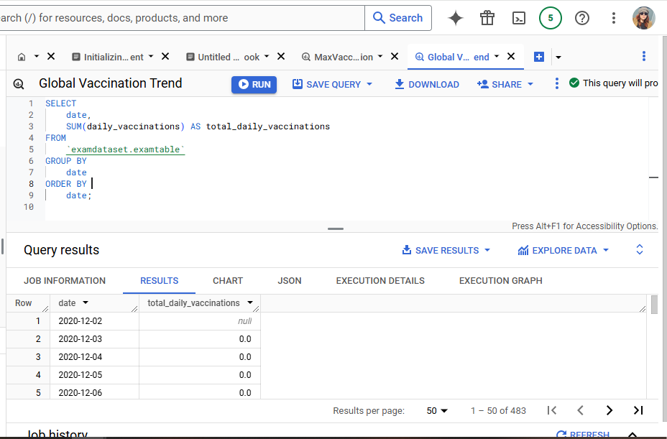
What is the daily vaccination trend globally?
2

Slide 23
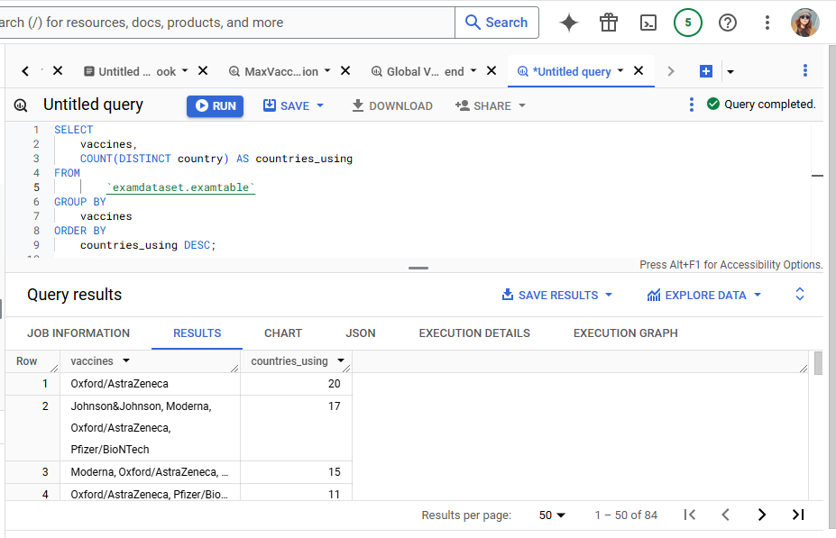
Which vaccine types are most commonly used worldwide?
3

Slide 24
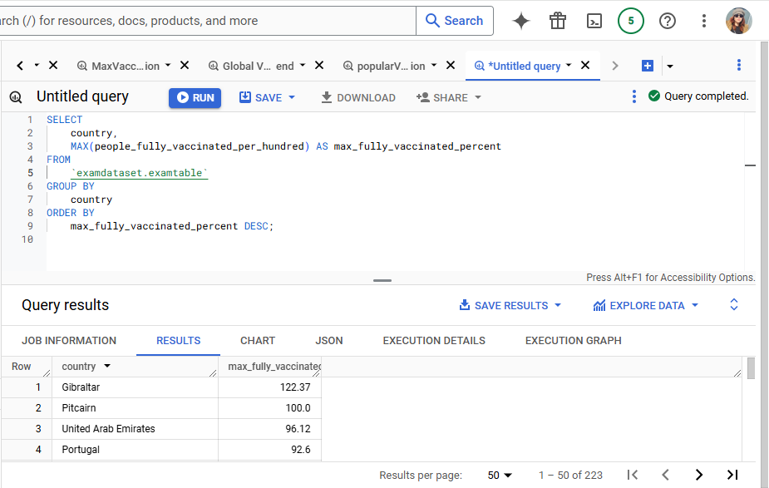
What percentage of the population has been fully vaccinated in each country?
4

Slide 25
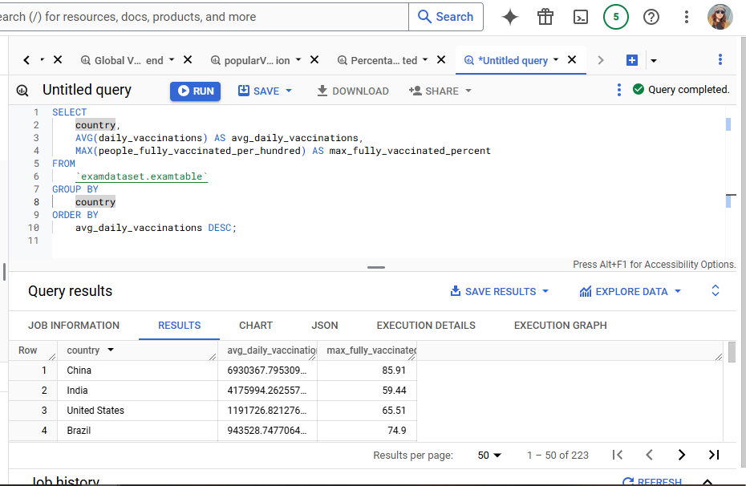
What is the relationship between daily vaccinations and the number of people fully vaccinated per country?
5

Slide 26
Executing the queries on Jupyter notebook

Slide 27
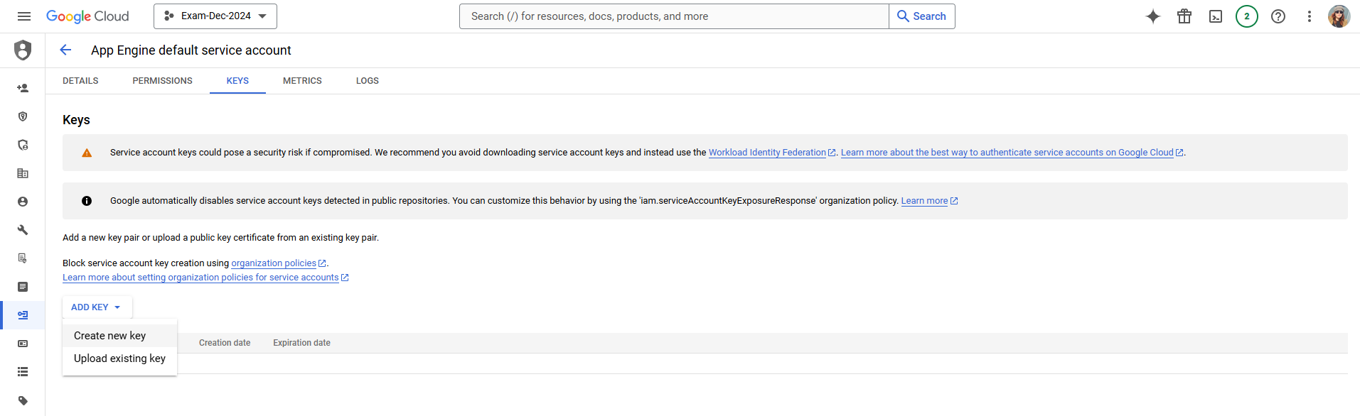
: Creating the JSON key

Slide 28
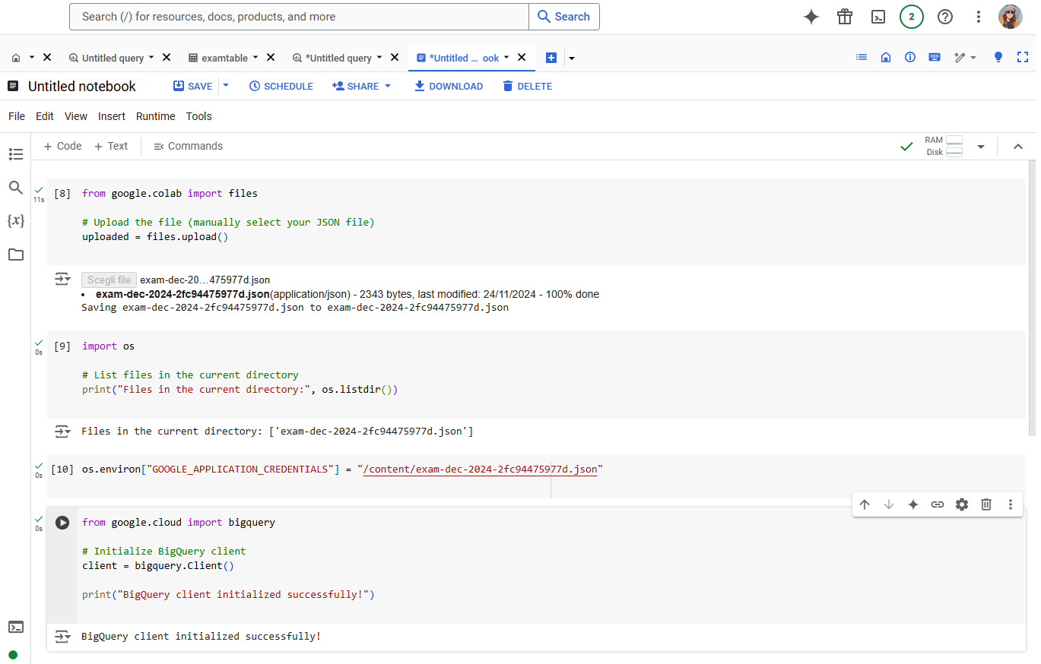
Uploading the Jason Key

Slide 29
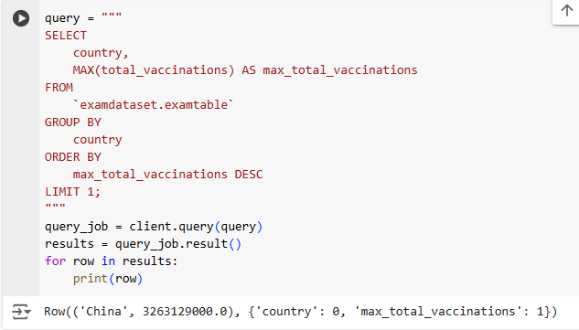
Which country has the highest total vaccinations?
1

Slide 30
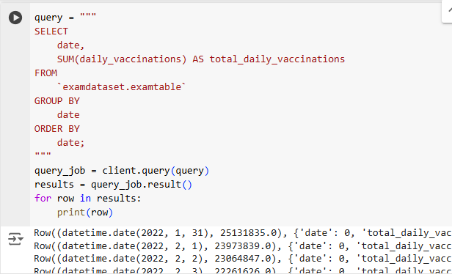
What is the daily vaccination trend globally?
2

Slide 31
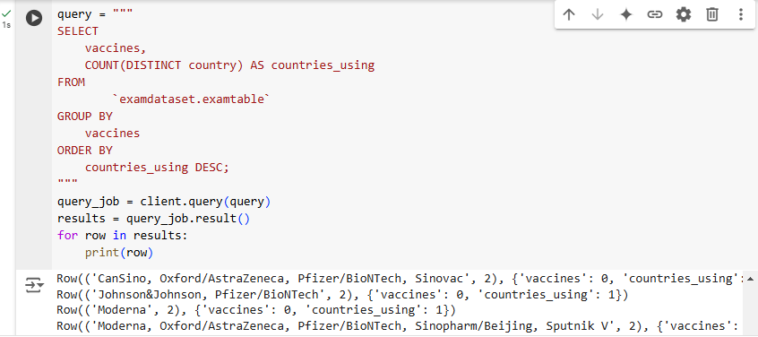
Which vaccine types are most commonly used worldwide?
3

Slide 32
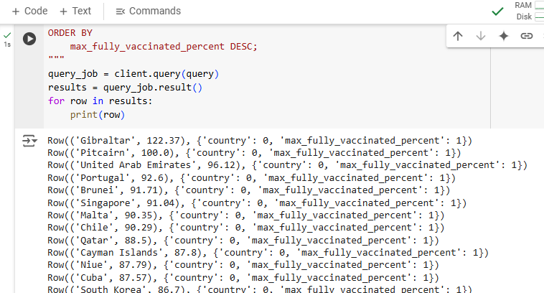
What percentage of the population has been fully vaccinated in each country?
4

Slide 33
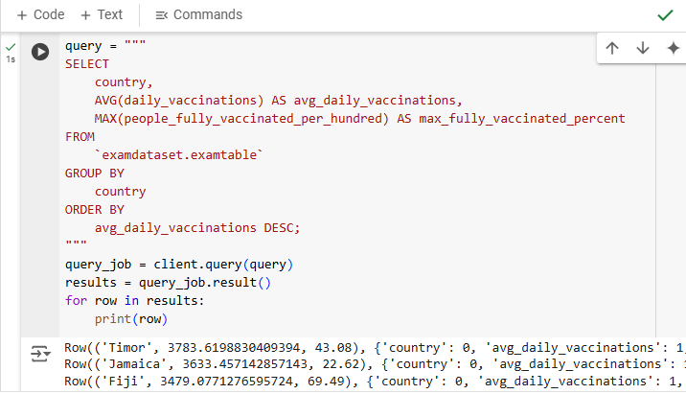
What is the relationship between daily vaccinations and the number of people fully vaccinated per country?
5

Slide 34
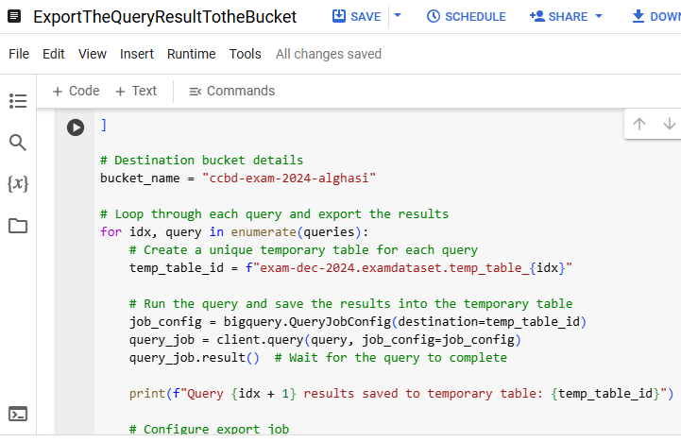
Exporting The Query Result To the Bucket-1

Slide 35
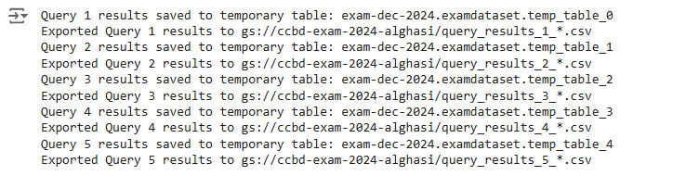
Exporting The Query Result To the Bucket-2

Slide 36
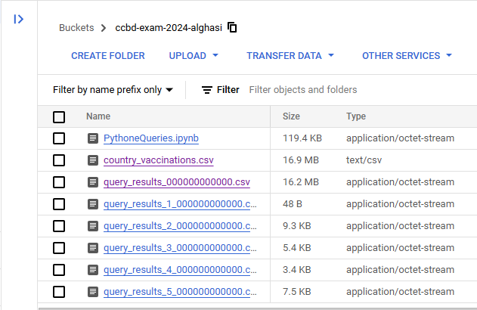
Exporting The Query Result To the Bucket-3

Slide 37
Git repository
https://github.com/mahtabalghasi88/CloudExam2024unict

Slide 38
04
DATA ANALYSIS USING SPARK NOTEBOOKS

Slide 39
ExecutingTheQueries
The link to the notebook in Databrick:
ExecutingTheQueries

Slide 40
05
DATA ENRICHMENT

Slide 41
Machine Learning Algorithm using Spark on Databricks
The link to the notebook in Databrick:
Exam2024Mlib

Slide 42
06
DATA VISUALIZATION

Slide 43
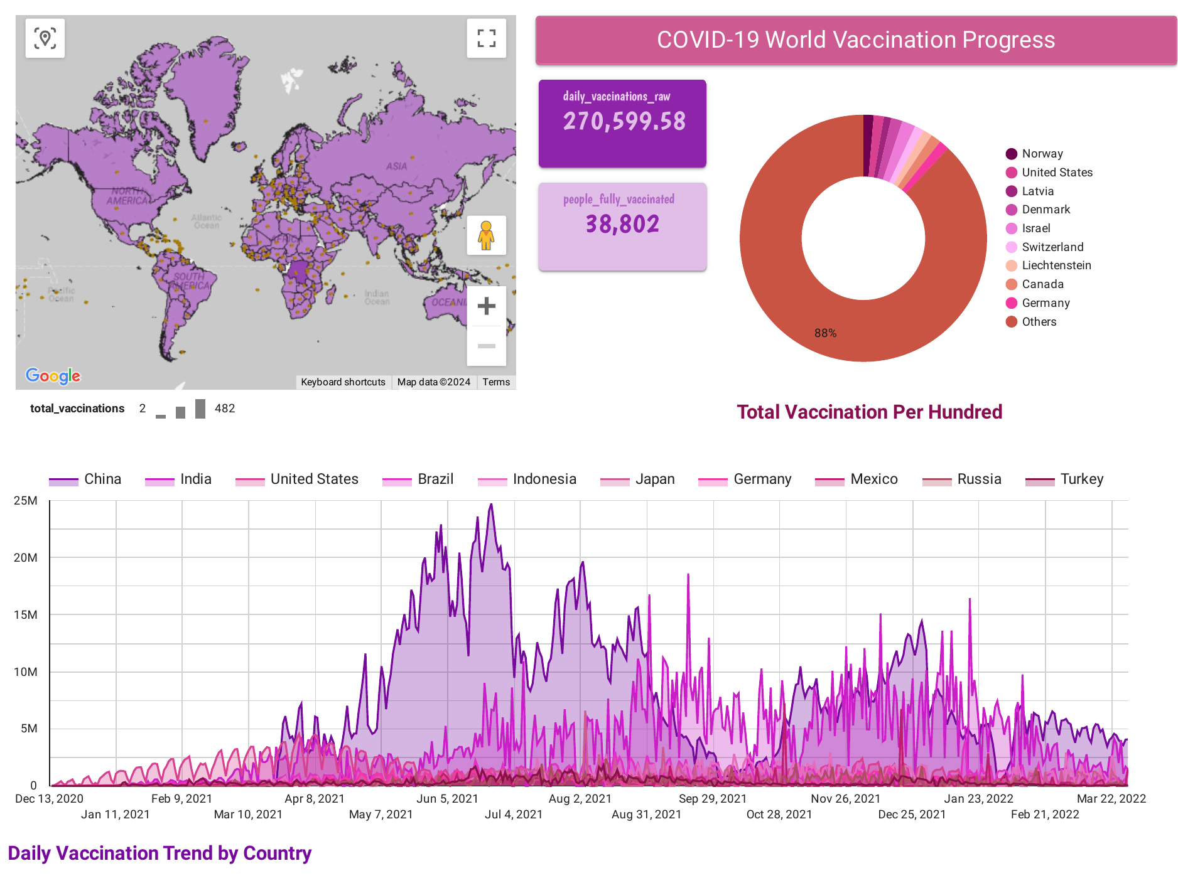
Dashboard representing the dataset and queries on Looker

Slide 44
Thank you!

